Slide 1

Python Fundamentals

Slide 2
Contents
2. PYTHON FUNDAMENTAL
2.1 Working with Interactive Mode.
2.2 Working with script mode.
2.3 Python character set.
2.4 Python Token, keywords, Identifiers,Literals,Operators variables,Assignments
2.5 Input and output in python

Slide 3
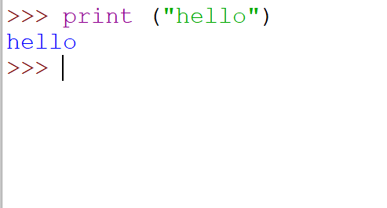
Interactive Mode

Slide 4
Interactive Mode
The interactive mode involves running your codes directly on the Python shell which can be accessed from the terminal of the operating system.
The code executes via the Python shell, which comes with Python installation.

Slide 5
Advantage and Disadvantage
The following are the advantages of running your code in interactive mode:
Helpful when your script is extremely short and you want immediate results.
Faster as you only have to type a command and then press the enter key to get the results.
Good for beginners who need to understand Python basics.
The following are the disadvantages of running your code in the interactive mode:
Editing the code in interactive mode is hard as you have to move back to the previous commands or else you have to rewrite the whole command again.
It's very tedious to run long pieces of code.

Slide 6
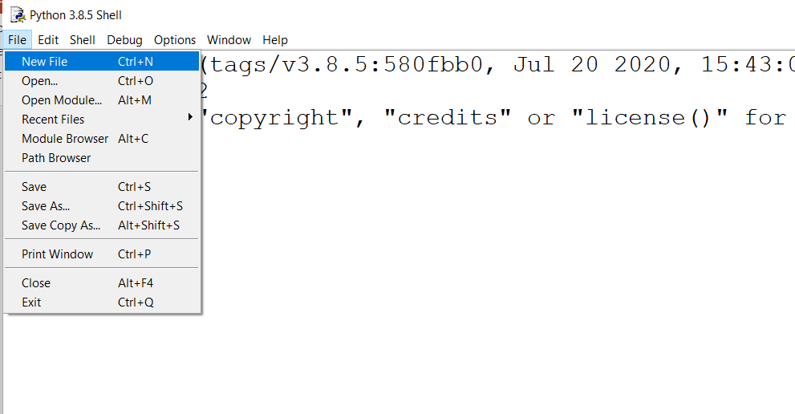
Script Mode

Slide 7
Creating new file
In script mode, You write your code in a text file then save it with a .py extension which stands for "Python". Note that you can use any text editor for this, including Sublime, Atom, notepad++, etc.
If you are in the standard Python shell, you can click "File" then choose "New" or simply hit "Ctrl + N" on your keyboard to open a blank script in which you can write your code. You can then press "Ctrl + S" to save it.
After writing your code, you can run it by clicking "Run" then "Run Module" or simply press F5.

Slide 8
Script Advantage and Disadvantage
The following are the advantages of running your code in script mode:
It is easy to run large pieces of code.
Editing your script is easier in script mode.
Good for both beginners and experts.
The following are the disadvantages of using the script mode:
Can be tedious when you need to run only a single or a few lines of code.
You must create and save a file before executing your code.

Slide 9
Difference between script mode and Interactive mode.
The interactive mode involves running your codes directly on the Python shell which can be accessed from the terminal of the operating system.
In the script mode, you have to create a file, give it a name with a .py the extension then runs your code.
The interactive mode is suitable when running a few lines of code.
The script mode is recommended when you need to create large applications.

Slide 10
2.3 Python character set
Character set is the set of valid characters that a language can recognize. A character represents any letter, digit or any other symbol.
Python has the following character sets:
· Letters – A to Z, a to z
· Digits – 0 to 9
· Special Symbols - + - * / etc.
· Whitespaces – Blank Space, tab, carriage return, newline, form feed
· Other characters – Python can process all ASCII and Unicode characters as part of data or literals.

Slide 11
Tokens
In a passage of text, individual words and punctuation marks are called tokens lexicalunite or lexical elements.
The smallest individual unit in a program is called token.
Python has the following tokens:
(i) Keyword (ii) Identifiers
(iii) Literals (iv) Operators
(v) Punctuators

Slide 12
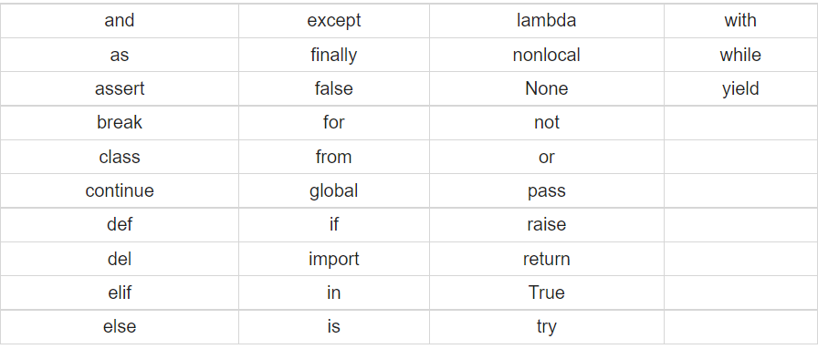
Reserved words
Reserved words also called keywords are defined with predefined meaning and syntax in python language. These keywords have to be used to develop programming instructions.
Reserved words can’t be used as identifiers for other programming elements like name of variable, function etc.

Slide 13
Variables or identifiers
A variable is created the moment we first assign a value to it. A variable is a name given to a memory location. It is the basic unit of storage in a program.
The value stored in a variable can be changed during program execution.
A variable is only a name given to a memory location, all the operations done on the variable effects that memory location.

Slide 14
Rules for creating variables
A variable name must start with a letter or the underscore character.
A variable name cannot start with a number.
A variable name can only contain alpha-numeric characters and underscores (A-z, 0-9, and _ ).
Variable names are case-sensitive (name, Name and NAME are three different variables).
The reserved words(keywords) cannot be used naming the variable.

Slide 15
Example
#Legal variable names:
myvar = "John"
my_var = "John"
_my_var = "John"
myVar = "John"
MYVAR = "John"
myvar2 = "John"
#Illegal variable names:
2myvar = "John"
my-var = "John"
my var = "John"

Slide 16
Continue..
we can name the variable in three ways which is,
complex way- In this way a normal user can even guess whats happening in the program.
eg: aseuikDFCS45Ghnd = 795
aseuikDFFG23Ghjd = 26
axzvmbnmlopys89 = aseuikDFCS45Ghnd * aseuikDFFG23Ghjd
print(axzvmbnmlopys89 )
easier way - It is the simplest form of our variable name.
eg: x = 795
y = 26
z = x * y
print(z)
both are the same problem but a viewer view too. so from second he gets what's the program is, but is it understandable. lets see next way too

Slide 17
Continue..
eg:
payment_per_day = 795
days_of_working = 26
total_salary = payment_per_day * days_of_working
print(total_salary)
so, this will be readable form or understandable form.
we can store various types of values in a variable and we can store a multiple values in a variable.
and we can assign(reference) a value to multiple variables and vice versa.

Slide 18
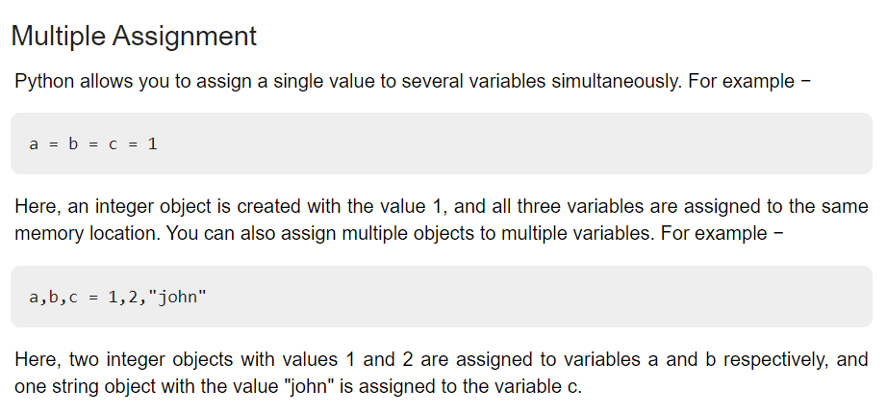
More on variables

Slide 19
Literals
Literals can be defined as a data which isgiven in a variable or constant.Python supports the following literals.
i.String literals
ii.Numeric literals
iii.Boolean literals
iv.Collection
v.special

Slide 20
Comments
Comments can be used to explain Python code.
Comments can be used to make the code more readable.
Comments can be used to prevent execution when testing code.
These are like taking notes while you code. This is for make more readable of your code.
A Comment start with #. in this one line of comment can be written.
print(“hello python”) #this prints hello python. (comment)

Slide 21
Eg :
we can write comments of so many line like this,
"""
This is a comment
written in
more than just one line"""
print("Hello, World!")

Slide 22
Thank You

